Slide 1
CS4225/CS5425 Big Data Systems for Data Science
Tutorial 2 Answers
Desmond Lau
School of Computing
National University of Singapore
dlau@nus.edu.sg

Slide 2
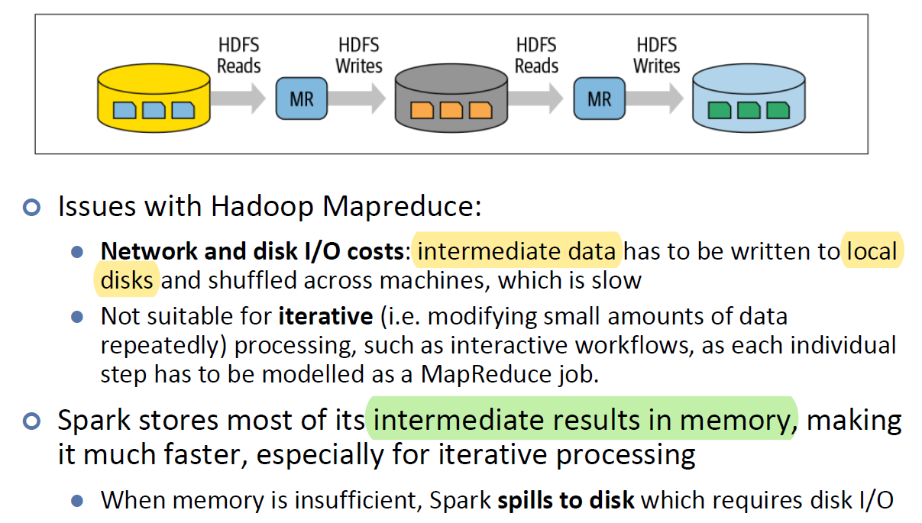
Question 1
Why is Spark more suitable for iterative processing compared to Hadoop?
Spark stores most of its intermediate results in memory, making it much faster, especially for iterative processing.
Lecture 7 - Slide 5

Slide 3
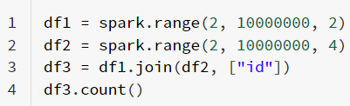
Question 2
In the below spark code block, please indicate which lines are transformation and which lines are action. For transformation, please also indicate whether it is a narrow transformation or wide transformation.

Slide 4
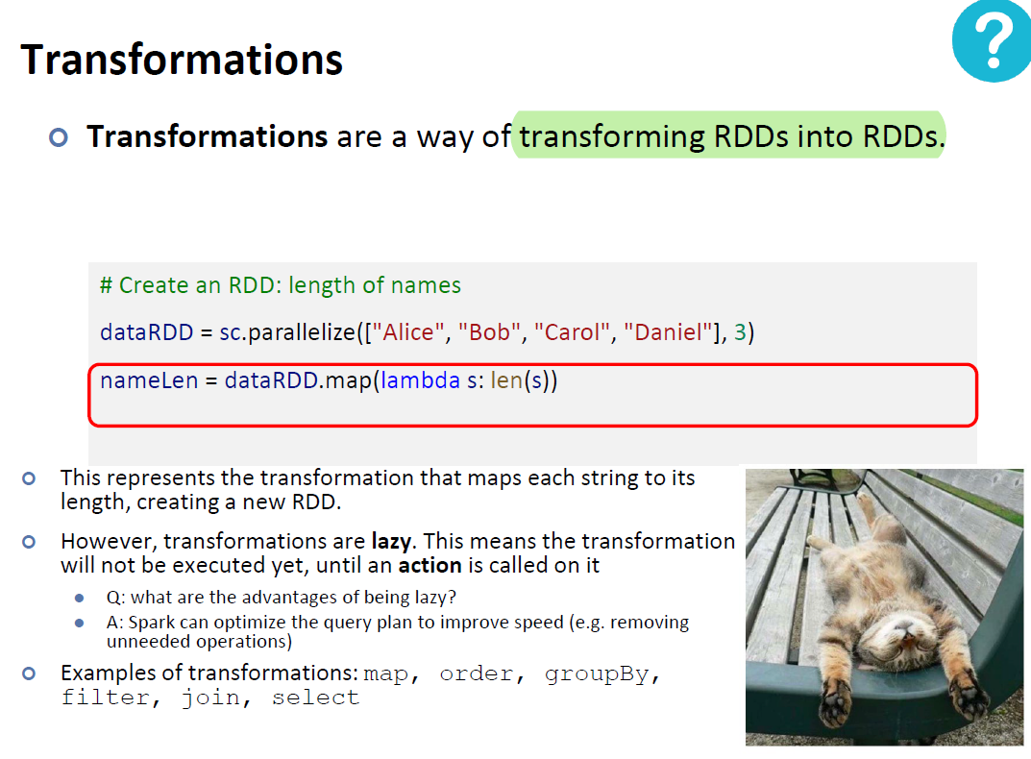
Lecture 7 - Slide 15

Slide 5
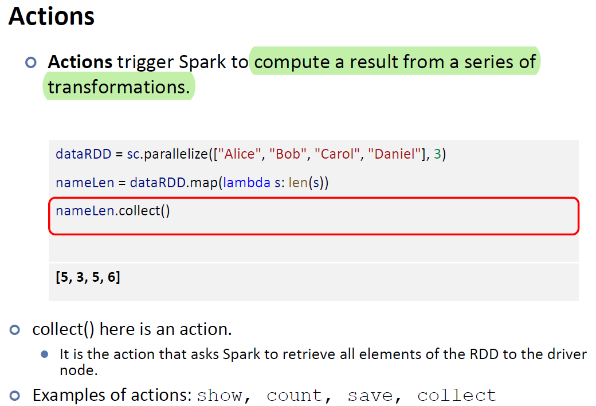
Lecture 7 - Slide 16

Slide 6
Question 2
In the below spark code block, please indicate which lines are transformation and which lines are action. For transformation, please also indicate whether it is a narrow transformation or wide transformation.
Line 1: Transformation
Line 2: Transformation
Line 3: Transformation
Line 4: Action

Slide 7
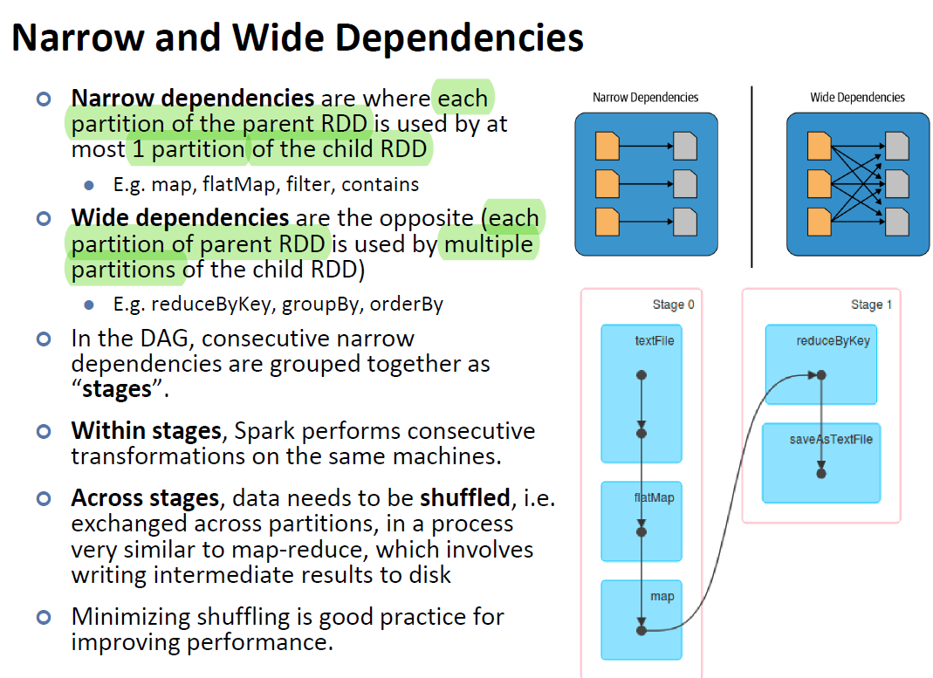
Lecture 7 - Slide 36

Slide 8
Question 2
In the below spark code block, please indicate which lines are transformation and which lines are action. For transformation, please also indicate whether it is a narrow transformation or wide transformation.
Line 1: Narrow Transformation
Line 2: Narrow Transformation
Line 3: Wide Transformation
Line 4: Action

Slide 9
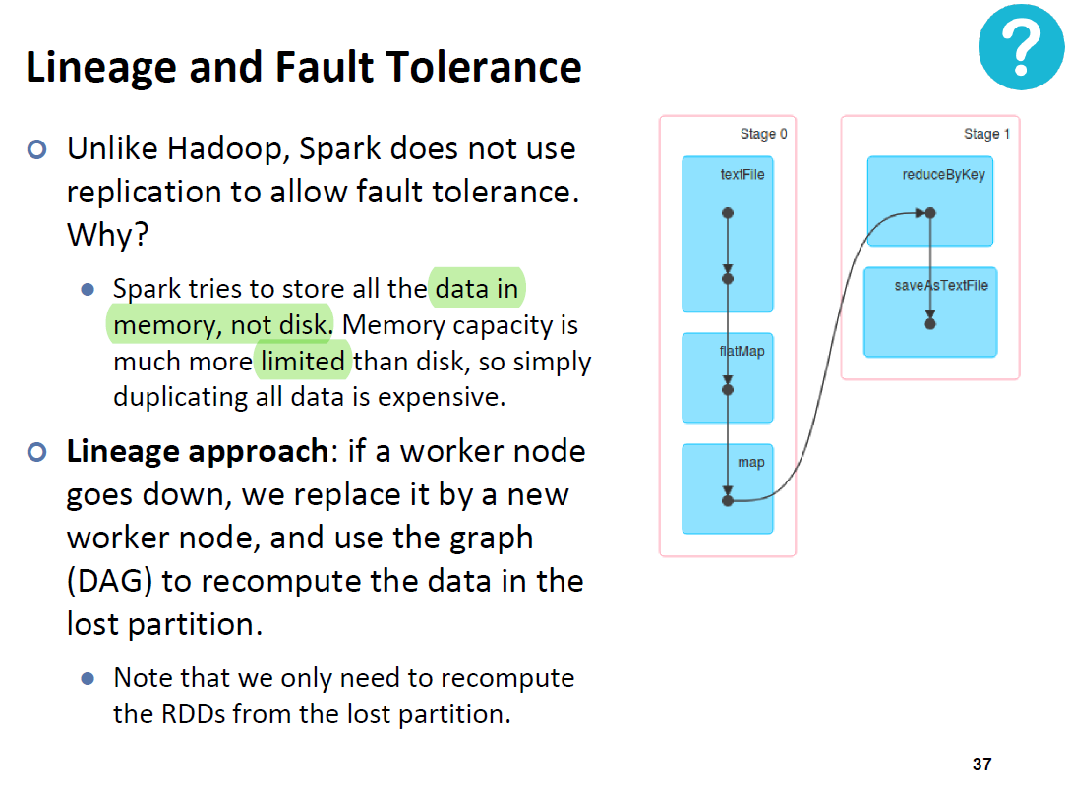
Question 3
In HDFS, each chunk is replicated three times by default. In contrast, in Spark, RDD uses lineage for reliability. What is a major problem if Spark also uses replications for reliability?
Consumes a lot of memory; memory is much scarcer than disk space
Lecture 7 - Slide 37

Slide 10
Question 4
Is it true that in Spark runtime, RDD cannot reside in the hard disk?
False. RDD can also be stored on disk if memory runs out
Lecture 7 - Slide 5

Slide 11
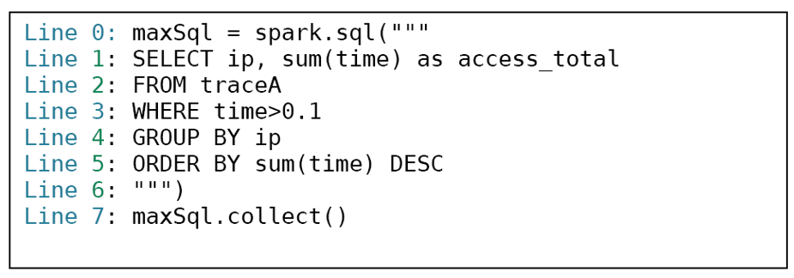
Question 5
On a certain large Spark cluster, Rose creates a data frame named traceA, and writes the shown program to process the trace.

Slide 12
Question 5
The traceA data frame keeps the logs, and each log entry represents the log information of one web page access, including various fields: ip, the IP address of the log entry and time, the amount of time of that access.

Slide 13
Question 5
For the above code, what are the potential performance bottlenecks? Please identify which lines cause the bottleneck and justify your answer.

Slide 14
Question 5
If the dataframe is not entirely in memory, reading traceA (Line 1-3) may incur potential I/O cost.

Slide 15
Question 5
Depending on the size of data generated from Line 3, Line 4 & 5 can also be the bottleneck as both operations are wide transformations and thus require data shuffling through the network.

Slide 16
Question 5
If the grouped data after Line 4 is highly skewed (e.g. disproportionately many rows for one ip address), Line 5 will have task straggler issues (some tasks requiring much more time than others).

Slide 17
Question 5
Line 7 may return too many results. We can add LIMIT to the SQL query to limit the number of results (e.g. adding the line ‘LIMIT 100’ after Line 5 to get the first 100 results).

